Slide 1
Sensor-Data
Collecting Data from a mobile phone’s sensors.

Slide 2

The task
Collect data from a mobile phone’s sensors
Create user interface
Transmit the data from the device to a central repository.
Conduct some meaningful analysis on this information
Create a RESTful API that is used to access the data
Using the API and visualization techniques, render the findings on a web page

Slide 3
Data collection task.
The application collects data from the microphone, accelerometer, GPS and camera.
Data is then stored on the device before being uploaded to an online server/database.
Notes:
Moved the file around to create a much better directory structure.
Leveraged folder structure of the Laravel 4 framework to organize modules and PSR 0 for Modules
Advantages
No directory traversal
Modules are seperate and can be reusable

Slide 4
Technologies Used
Java(Android studio

Slide 5
Challenges
Building an API
GPS accuracy offset
Noise decibel levels in some cases are too high or too low to make meaningful analysis from them.
Time factor

Slide 6
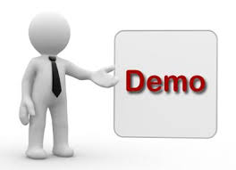

Slide 7
Future work
Integrating the different sensors to automatically capture data based on the behaviors/data collected from the different components.
Develop a RESTful API
Implement the server side/Back end completely

Slide 8
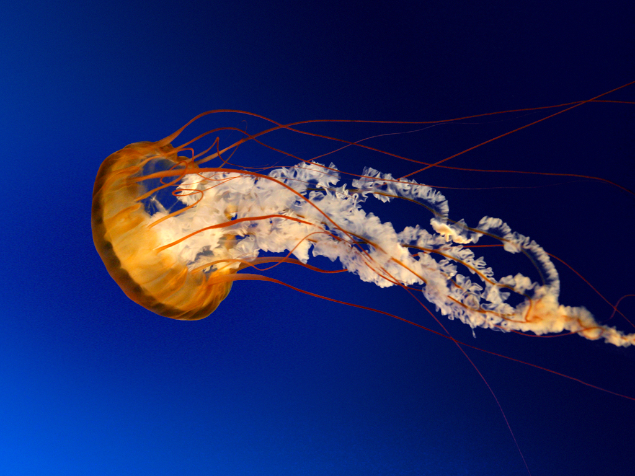
Thank you

